Slide 1
In the dark
“Hello darkness, my old friend”
Board game by MaJaSlaTiPla

Slide 2
VS
Dead by daylight
In the dark
1 killer vs 4 survivors
Survivors’ goal: escape, open the exits by starting up the generators/engines
Killer’s goal: kill all the survivors
Hide and seek
Perks(first aid kit, toolbox, etc.) are gained from leveling up
1 killer vs 2 to 4 survivors
Survivors and Killers share the same goals as the original game
Advanced Tag
Cards instead of perks
Secret pathways/tunnels

Slide 3
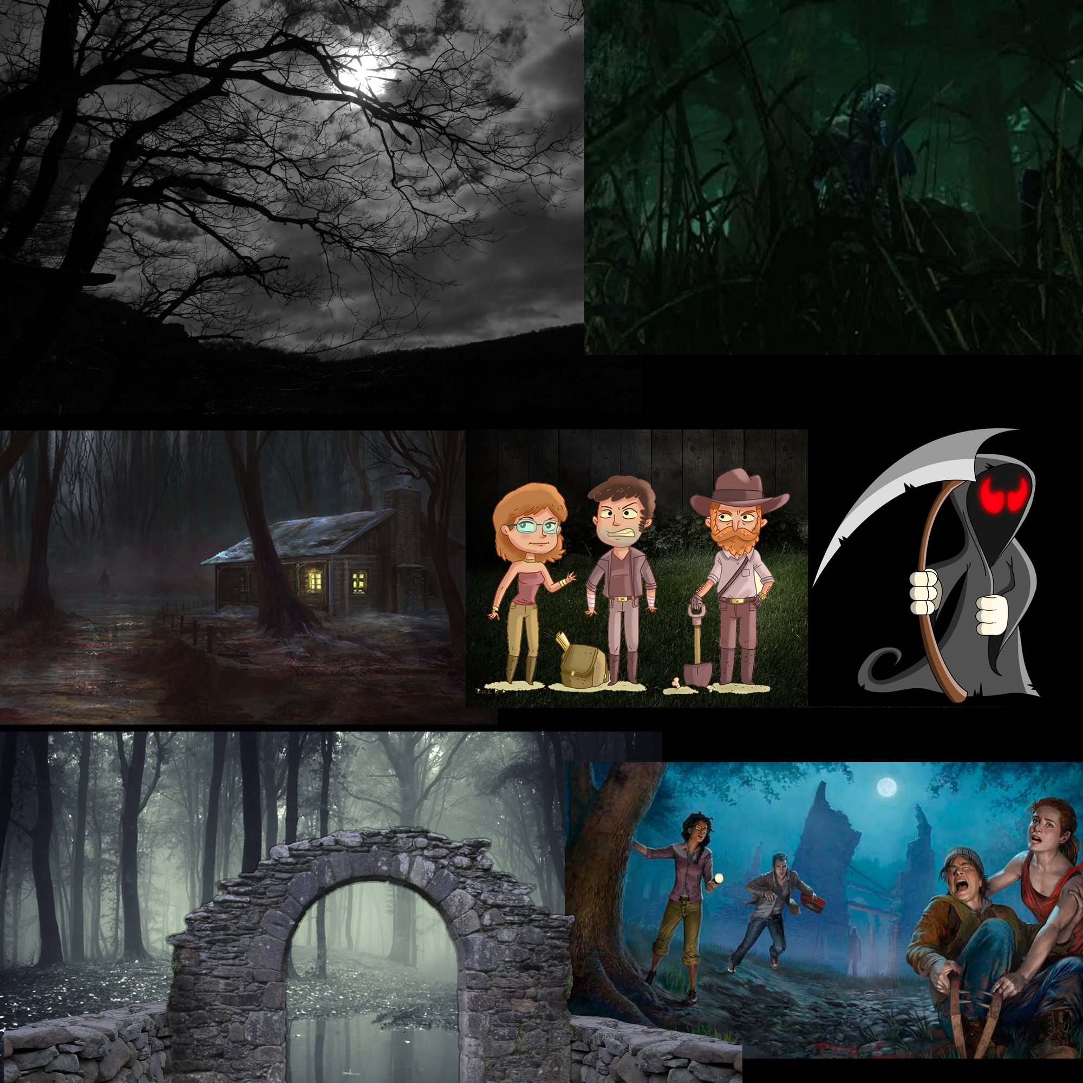
Moodboard

Slide 4
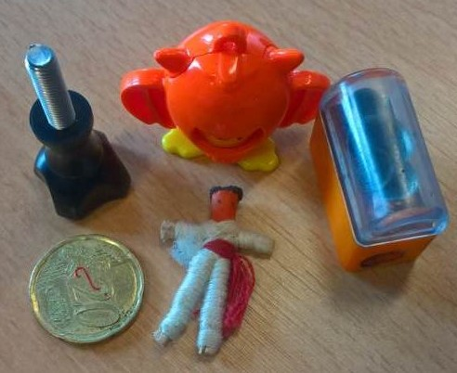
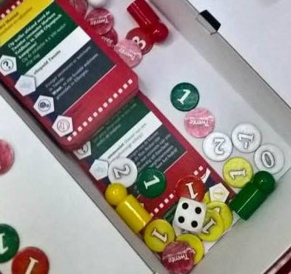
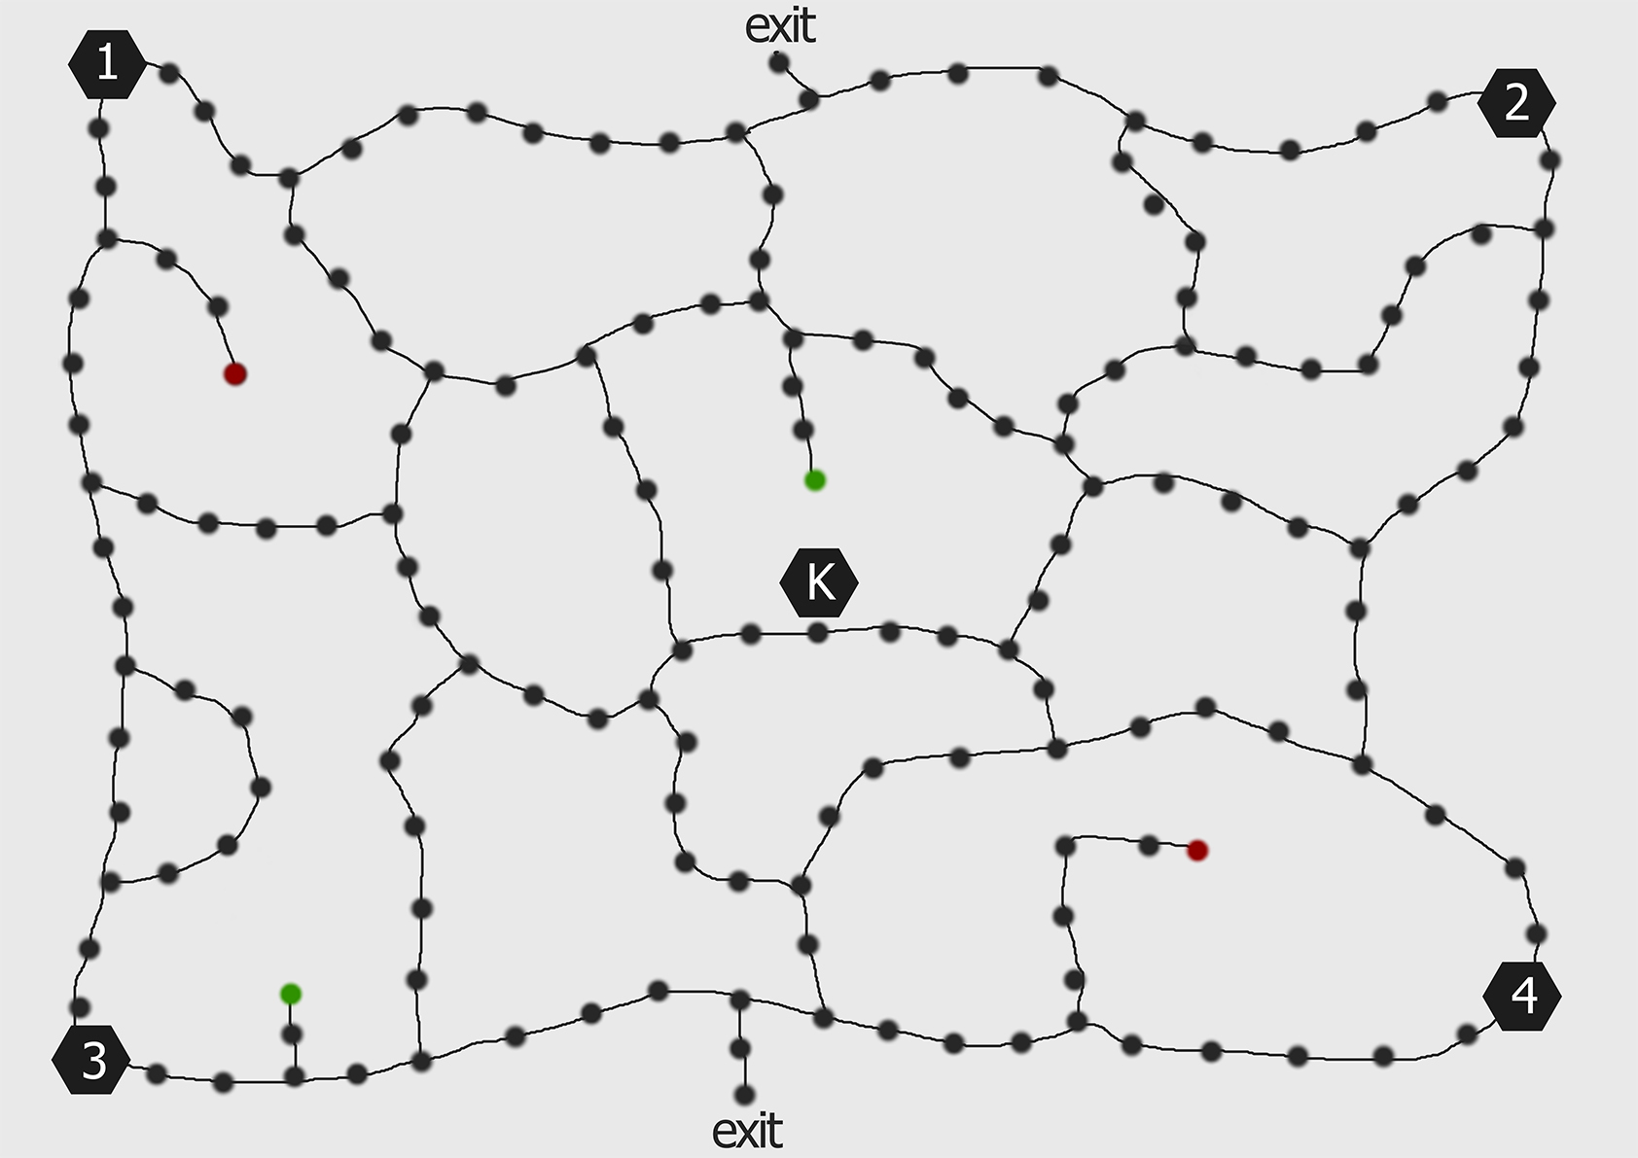
prototype
First prototype
Difficulties:
Balancing
Map layout
Improvements:
Tunnels
Card balancing
More dots, thus “bigger” map
Tokens and characters

Slide 5
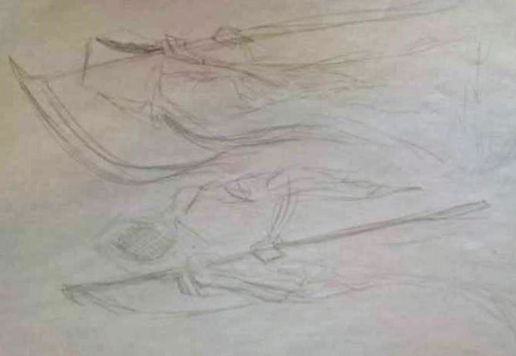
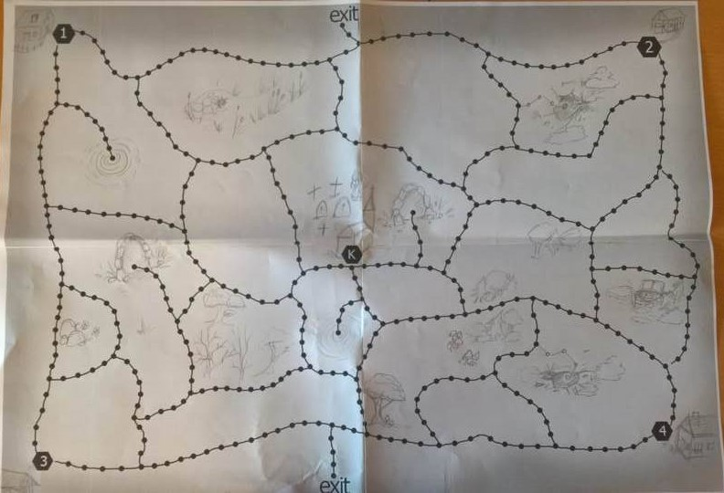
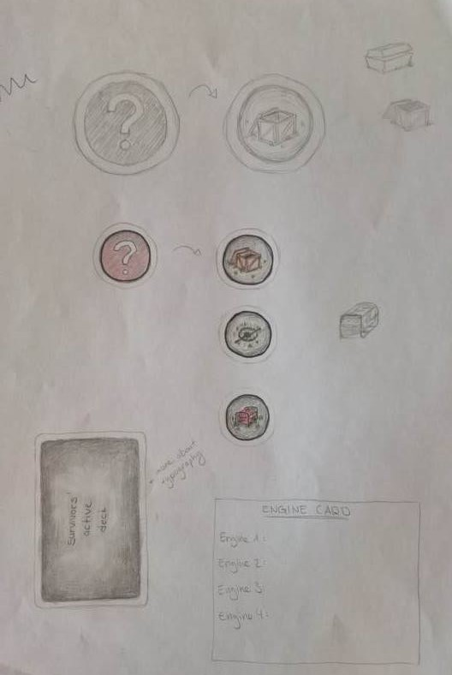
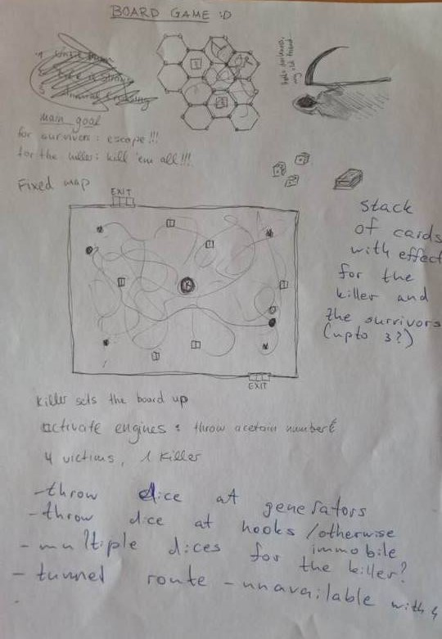
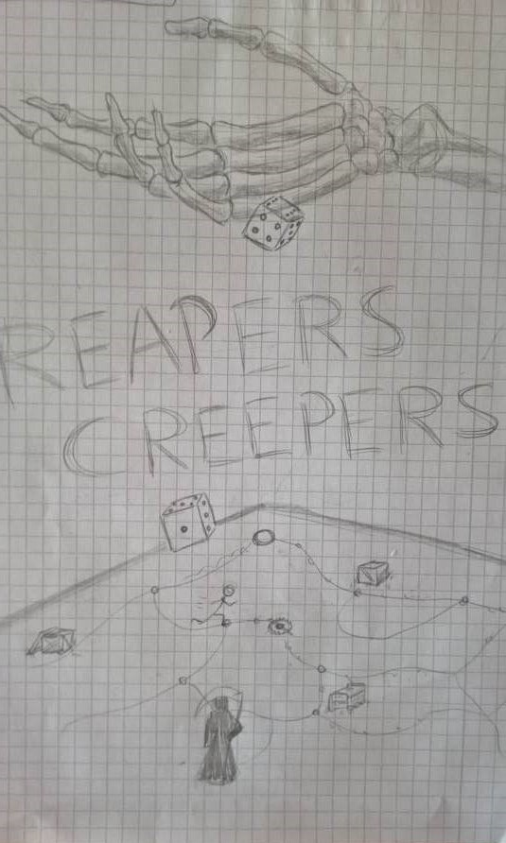
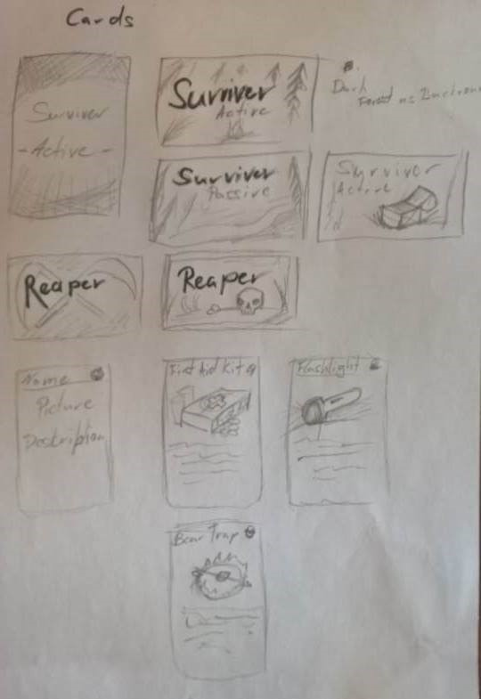
Concept art

Slide 6
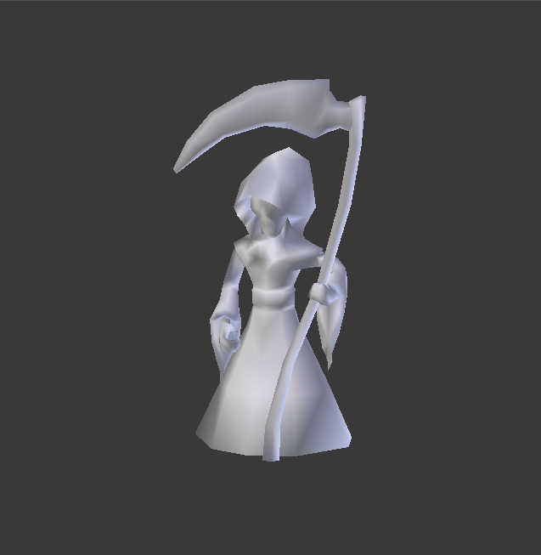
3D work done

Slide 7
Future planning
Craft board (team)
3D print pawns (Tim)
Design cards (Jacqueline)
Create engine cards (Mathilde)
Print rule book (Plamen and Slavi)
Poster (Designers)
Trailer editing (Plamen)

